Slide 1



Machine Learning Models
Machine learning models are computer programs that learn from data to perform specific tasks without explicit programming. They are becoming increasingly prevalent in various applications.
by Juvenile teachers

Slide 2

Supervised Learning Models
Supervised learning models learn from labeled data, where each example has an input and a corresponding output. They are used for tasks like classification and regression.
1
Classification
Assigning data points to predefined categories based on their features.
2
Regression
Predicting continuous values, such as price or temperature, based on input features.

Slide 3
Unsupervised Learning Models
Unsupervised learning models learn from unlabeled data, identifying patterns and structures without explicit guidance. They are used for tasks like clustering and dimensionality reduction.
Clustering
Dimensionality Reduction
Grouping data points based on their similarities, creating clusters of related data.
Simplifying data by reducing the number of features while preserving important information.

Slide 4

Multimodal Models
Multimodal models process and integrate data from multiple sources, like text, images, and audio, to create a richer understanding of the world.
Text and Image
Captioning images, generating descriptions based on visual input.
Image and Audio
Creating soundtracks for videos, identifying objects based on sounds.
Text and Audio
Speech recognition, generating text from spoken language.

Slide 5
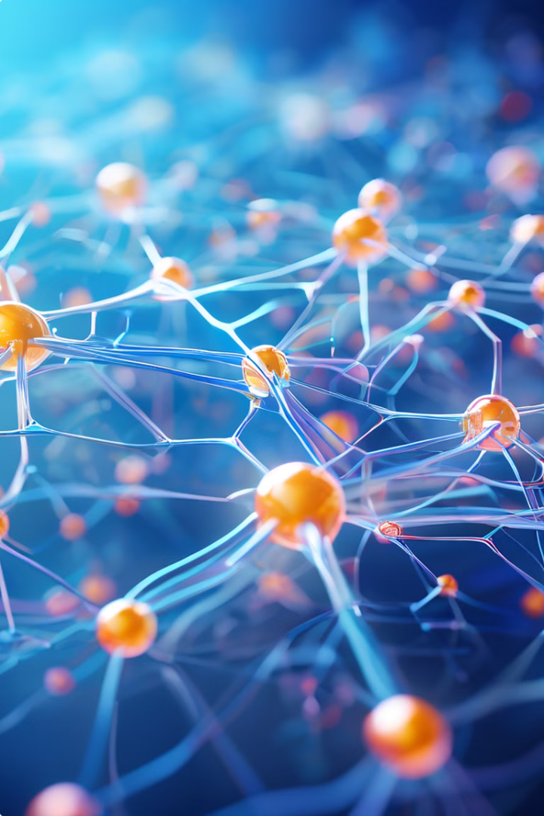



Foundation Models
Foundation models are large-scale, pre-trained models that have been exposed to massive amounts of data, enabling them to perform a wide range of tasks with high accuracy.
General Purpose
Capable of handling a variety of tasks, including language translation and question answering.
Fine-tuning
Adapting to specific tasks through further training on smaller datasets.
Specialized Applications
Used in fields like healthcare, finance, and education.

Slide 6

Advantages of Multimodal and Foundation Models
Multimodal and foundation models offer significant advantages over traditional models, including improved accuracy, efficiency, and versatility.
Enhanced Accuracy
Ability to process and integrate data from multiple sources, leading to more comprehensive and reliable results.
Increased Efficiency
Pre-trained models can be adapted to new tasks with less training data, saving time and resources.
Broad Applicability
Their versatility allows them to be used for a wide range of applications, making them valuable across various industries.

Slide 7

Fine-tuning Multimodal and Foundation Models
Fine-tuning involves adapting a pre-trained model to a specific task by training it on a smaller dataset relevant to the desired outcome.
Data Preparation
Evaluation and Refinement
Gathering and preparing a dataset relevant to the specific task.
Assessing the model's performance and making further adjustments to improve its accuracy.
1
2
3
Model Adaptation
Adjusting the model's parameters to optimize its performance for the new task.

Slide 8





Conclusion and Key Takeaways
Machine learning models, especially multimodal and foundation models, are revolutionizing various fields. By understanding their capabilities and applications, we can harness their potential to solve complex problems and drive innovation.
Data-Driven Insights
Unlocking valuable knowledge from data to make informed decisions.
Automated Processes
Automating tasks and improving efficiency through intelligent systems.
Predictive Analytics
Forecasting future trends and patterns for strategic planning.
Global Impact
Transforming industries, improving lives, and shaping the future.

